Slide 1
《英语国家社会与文化入门》(上册）
The Society and Culture
of Major English-Speaking Countries
An Introduction
(Book One)

Slide 2
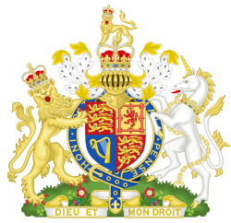
The United Kingdom of Britain and Northern Ireland
Unit 9 The British Media

Slide 3
Quiz
Give the English and a brief explanation for the following:
1 监督者
2 《泰晤士报》
3 《卫报》
4 英国广播公司
5 多媒体

Slide 4
Focal Points
popularity and functions of the media
the quality press
The Observer
The Times
The Guardian
The Telegraph
The Financial Times
Tabloids
The British Broadcasting Corporation (BBC)
The Independent Television Commission

Slide 5
The Unit Is Divided into Three Sections
I. The Role of Media
II. British Newspapers
III. The Broadcast Media

Slide 6
I. The Role of Media
The media are central to British leisure culture;
The media provide British people with information about political and social issues, and are considered to be vital to the British political system;
The media provide weather reports and carry advertising;
The media are used for educational purposes and provide a forum for people to express their views;
The media plays an important role in engendering a national culture.

Slide 7
II. British Newspapers
More and more newspapers began to appear in the late eighteenth and early nineteenth century as the British economy began to industrialise, as the democratic franchise was extended to larger segments of the population, and as literacy levels rose through the introduction of mass education.
The very names of British newspapers --The Times, The Observer, The Guardian-- suggest that the function of the paper is to offer the electorate objective reports about what is happening in the country. This watchdog function, keeping an eye on the government, is one of the reasons why a free press is considered so important to the functioning of parliamentary democracy.

Slide 8
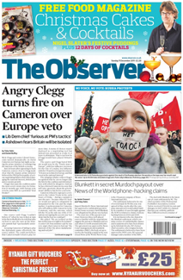
II. British Newspapers
The Observer, which is published every Sunday, first appeared in 1791, making it the world’s oldest Sunday newspaper. It takes a social liberal or social democratic line on most issues. The main paper comes with a number of supplements – Sport, The Observer Magazine, The New Review and The New York Times International Weekly.

Slide 9
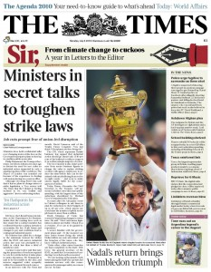
II. British Newspapers
The Times, which began publishing in 1785, is the United Kingdom’s oldest daily newspaper. its sister paper The Sunday Times was founded in 1821. The Times had an average daily circulation of 394,448 in March 2014. An American edition of The Times has been published since 6 June 2006. Though traditionally a moderate newspaper and sometimes a supporter of the Conservative Party, it supported the Labour Party in the 2001 and 2005 general elections.

Slide 10
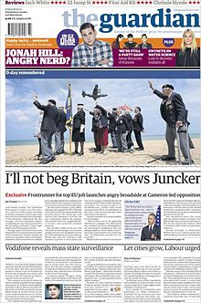
II. British Newspapers
The Guardian is a British national daily newspaper. Founded in 1821. It is the most left wing of the UK papers. In August 2013, The Guardian in paper form had an average daily circulation of 189,000 copies. The Guardian was named newspaper of the year at the 2014 British Press Awards, for its reporting on government surveillance. The newspaper’s online edition was the third most widely read in the world as of June 2012. Its combined print and online editions reach nearly 9 million readers.

Slide 11
II. British Newspapers
Advertising is carried in newspapers. The British media all must follow the Advertising Code which ensure that advertisements are legal, decent, honest and truthful; have a sense of responsibility for consumer and society; and respect the principles of fair competition.
British newspaper culture is unusual in the extent to which class and educational differences are reflected in the newspapers people read. Britain has one of the highest levels of newspaper sales per head of population, and there are over 1400 different newspapers which cater for a wide range of political views, interests and levels of education.

Slide 12
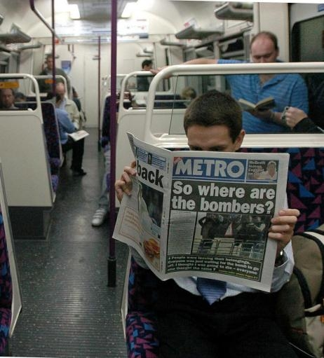
II. British Newspapers
British newspaper culture is unusual in the extent to which class and educational differences are reflected in the newspapers people read. Britain has one of the highest levels of newspaper sales per head of population, and there are over 1400 different newspapers which cater for a wide range of political views, interests and levels of education.
Reading a newspaper in a tube train

Slide 13
II. British Newspapers
Different types of newspapers:
-Daily national papers: Newspapers which are available throughout the country and cover issues of national importance.
-“Quality press”: Usually broadsheets, the quality papers carry more serious and in-depth articles of particular political and social importance. They also carry reviews and feature articles about high culture and will generally be read by a well-educated, middle class audience. The Time , The Observer, The Guardian are quality papers.
-“The tabloids”: Only half the size of the broadsheet papers, the tabloids are smaller format newspapers with colour photos and catchy headlines. They are often called “the gutter press” because they deal in scandals and gossip, usually about famous people, whether in politics, sports or entertainment, and carry lots of crime, sports and sensational human interest stories.

Slide 14

II. British Newspapers
The Sun is a daily tabloid newspaper published in the United Kingdom and Ireland. It had a large circulation with an average daily circulation of 2,069,809 copies in March 2014.

Slide 15
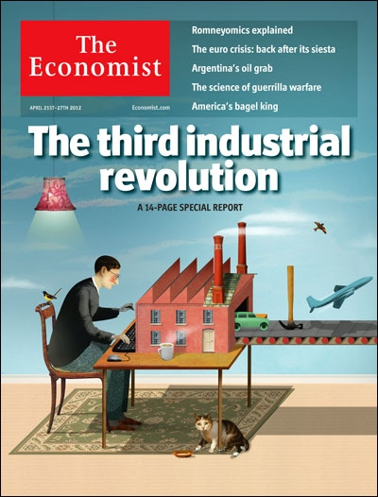
II. British Newspapers
The Economist is an English-language weekly newspaper, edited in offices in London. In 2006, its average weekly circulation was reported to be 1.5 million, about half of which were sold in the United States. The Economist's primary focus is world news, politics and business, but it also runs regular sections on science and technology as well as books and the arts. It targets highly educated readers and claims an audience containing many influential executives and policy-makers.

Slide 16
II. British Newspapers
Television and the Internet have brought great changes to mass media. By the late 1990s, news was available 24 hours a day on television channels, and then on the Internet, and now even on the cell phone. The constantly changing new developments of technologies have posed a challenge to the traditional business model of newspapers in Britain. For instance, The Times was printed in broadsheet format for 219 years, but switched to compact size in 2004 in an attempt to appeal more to younger readers and commuters using public transport. Major newspapers in the UK have launched online editions in an attempt to follow or stay ahead of their audience.

Slide 17

Despite the changes, many British people still have the habit of beginning their day by reading a newspaper at breakfast.

Slide 18
III. The Broadcast Media
The role of the broadcast media in British life:
-On average, British people spend 4 hours a day watching TV, and not participate in British television viewing is to cut oneself off from British culture and society;
-What do British people watch? News, entertainment, and sport are the favorites;
-Britain has long-running soap operas. They present gritty and realistic accounts of the everyday life of Britons, often tacking contemporary social issues like racism, AIDS, homosexuality, divorce, drug abuse, family violence and so on;
-British news are renowned for the quality of their reporting.

Slide 19
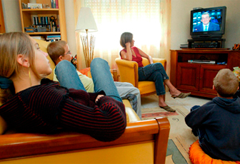
A family watching TV

Slide 20
Coronation Street
Coronation Street is a British soap opera, first broadcast on in 1960. The programme centres on the lives of the residents of Coronation Street in a fictional town. Coronation Street is noted for its depiction of a down-to-earth working class community combined with light-hearted humour and strong characters. Within six months of its release, it became the most-watched programme on British television. It has been one of the most financially lucrative programmes on British commercial television. On 17 September 2010, it became the world's longest-running TV soap opera in production.

Slide 21
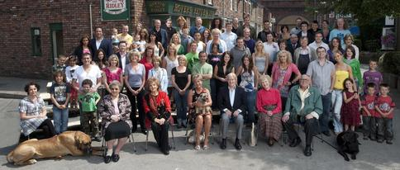
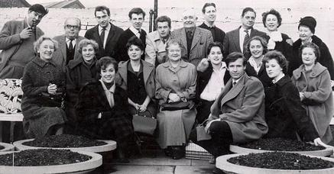
Left: Coronation Street cast photo in 1960
Right: The 50th anniversary of Coronation Street cast photo in 2010

Slide 22
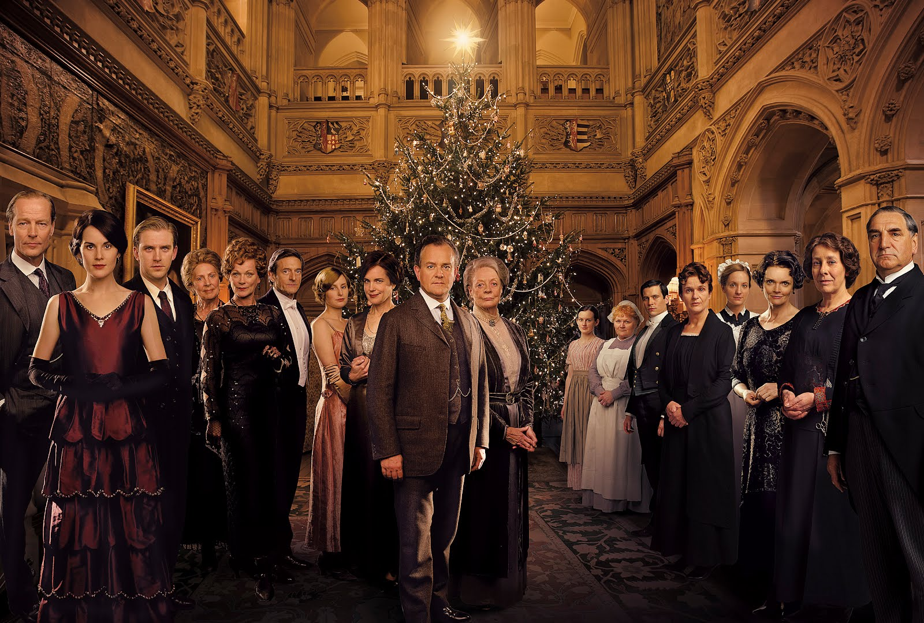
Downton Abbey
Downton Abbey is a popular British costume drama television series It first aired on TV on 9 January 2011 and have had four series over the past three years. The drama series, set in the fictional Yorkshire country estate of Downton Abbey, depicts the lives of the aristocratic Crawley family and their servants in the post-Edwardian era. Downton Abbey has received critical acclaim from television critics and won numerous awards, including an Emmy Award.

Slide 23
III. The Broadcast Media
The British Broadcasting Corporation (BBC):
- BBC is a UK based international public service broadcaster headquartered in London. It is the world's oldest national broadcasting organisation and the largest broadcaster in the world by number of employees, with about 23,000 staff.
-It was founded in 1922 as a public service radio station, and later moved into TV.
-BBC TV was renamed BBC1 when sister channel BBC2 was launched in 1964. They are now called BBC One and BBC Two. BBC One specializes in shows with broad appeal, such as sport, entertainment, current affairs, drama, and kids shows. It is currently the most watched television channel in the United Kingdom. BBC Two aims at a wide range of subject matter and interests, specialising in intelligent yet popular programme genres.
-With the new development in media technologies, more BBC channels have been launched sincer the beginning of the 21st century.

Slide 24

Logo used since 1997
The British Broadcasting Corporation, BBC:
-The work of BBC is funded principally by an annual television licence fee. It is charged to all British households, companies and organisations using any type of equipment to receive live television broadcasts. The level of the fee is set by the British Government, agreed by Parliament and used to fund the BBC's extensive Radio, TV and Online services covering the nations and regions of the UK.
-The BBC is no longer just about TV shows. Nowadays it is a multimedia business with wide publishing and educational interests. Not only can you watch BBC shows about cars, pop music, cooking, holidays and gardening, but you can buy magazines which complement the shows by providing further information, recipes, and competitions.

Slide 25
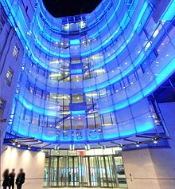
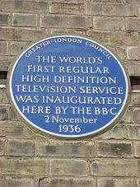
The British Broadcasting Corporation (BBC)
BBC New Broadcasting House, London

Slide 26

III. The Broadcast Media
ITV is a commercial TV network in the UK. Launched in 1955 as Independent Television under the auspices of the Independent Television Authority it is to provide competition to the BBC. It is also the oldest commercial network in the UK. ITV is a network of television channels that operate regional television services as well as sharing programmes between each other to be displayed on the entire network.
Logo of Independent Television

Slide 27
III. The Broadcast Media
TV and British politics:
- Given the vast amounts of coverage in British homes, TV, like the press, is very important to British politics. TV places different demands on politicians and so the whole style of politics has changed. With TV, politicians literally “come into our living room,” and so they have to seem more relaxed and friendly, as if theyriti are speaking to people personally. Long speeches are out; contemporary politicians have just 2 to 3 minutes to get their messages across, before the attention of the viewer drifts and they change the channel.

Slide 28
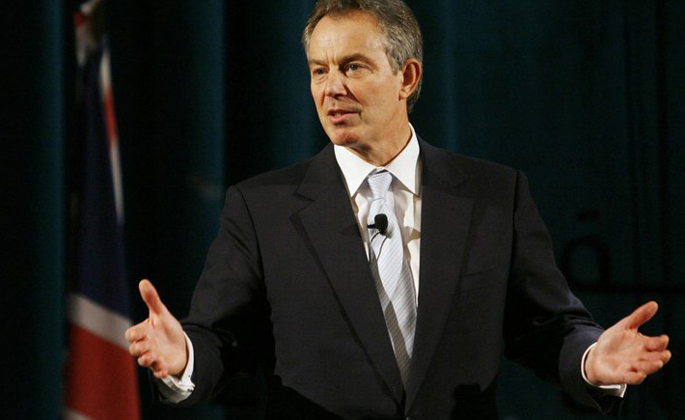
Speaking on BBC, former Prime Minister Tony Blair defended his policy about the war in Iraq six years after he led Britain into the war.

Slide 29
III. The Broadcast Media
TV and British politics:
-After much reluctance, the House of Commons finally agreed to allow its sessions to be televised in 1990. While Commons debates are always open to the public, parliamentarians feared the power of the camera. Politicians from all parties spend a lot of time worrying about their TV images.

Slide 30
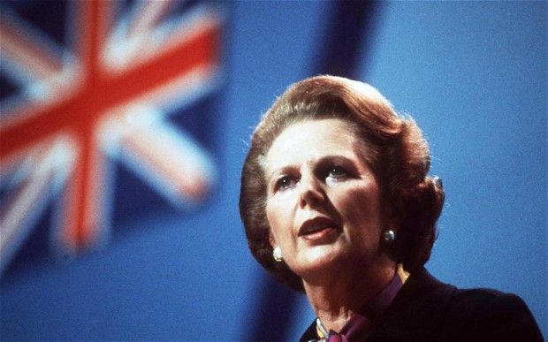
One example to show politicians’ concern about their public image is that Mrs. Thatcher took lessons from a voice coach who taught her to speak in a deeper voice more befitting a serious national leader, and changed her hair colour, make-up and clothing in order to enhance her dignified image.

Slide 31
Questions for Discussion
A. What role do the media play in British culture? What are some of the similarities and differences in terms of functions between the British media and the Chinese media?
B. What are some of the characteristics of British newspaper culture?
C. Is the British press free from the government control and censorship? What is the relationship between the press and politics in Britain?
D. How does the BBC operate?

Slide 32
The End
高等教育出版社
2015

